Slide 1
Smart Farming
Submitted in the partial fulfillment for the award of the degree of
BACHELOR OF ENGINEERING
IN
BE CSE (IOT)
Submitted by:
RAGHAV GOEL
(18BCS4505)
Vanshika Sanan
(18BCS4535)
Yuvraj sharma
(18BCS4508)
Vanshita Manral
(18BCS4522)
Under the Supervision of:
Rana Gill
Department of AIT-CSE
DISCOVER . LEARN . EMPOWER

Slide 2
Outline
Introduction to Project
Problem Formulation
Objectives of the work
Methodology used
Results and Outputs
Conclusion
Future Scope
References

Slide 3
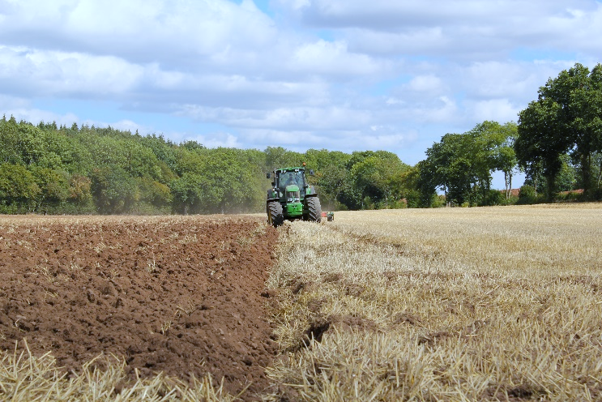
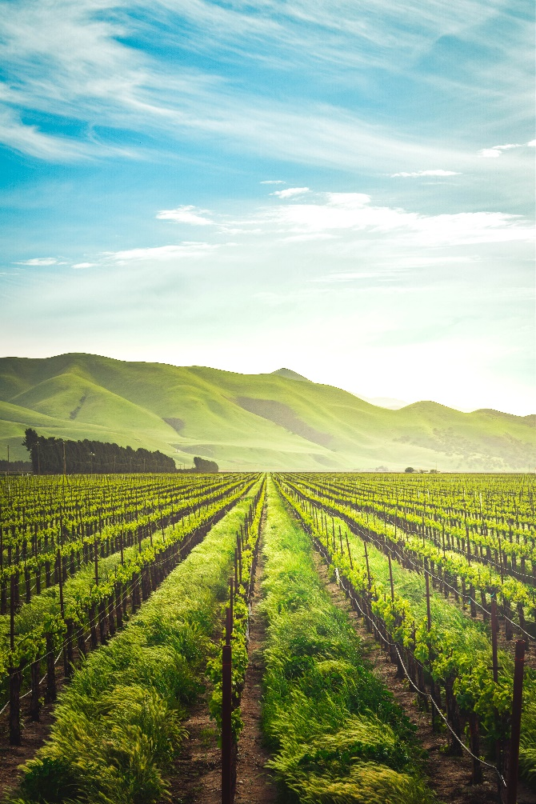
Introduction to Project
A smart farming project, capable of sensing the soil moisture along with the humidity and temperature. This project in short is a helping hand to our farmers which gives them the idea about some parameters that should be considered in order to get the better yield.

Slide 4
Problem Formulation
Why do we need smart farming?
For saving resources like water.
For better yield.
For increase in quality of production.

Slide 5
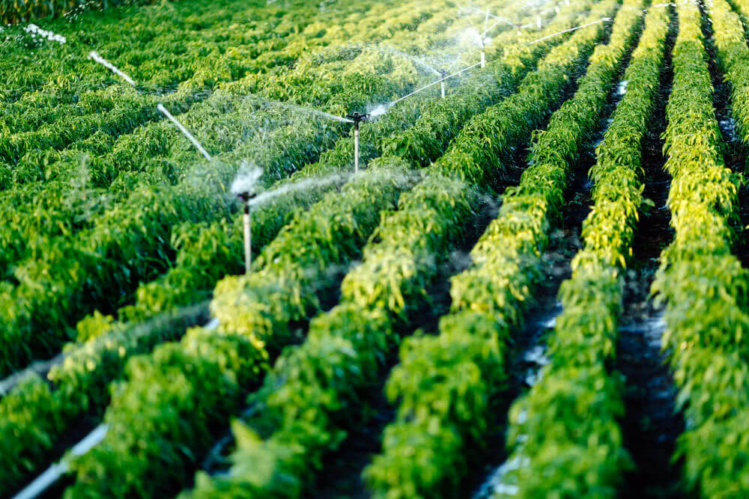
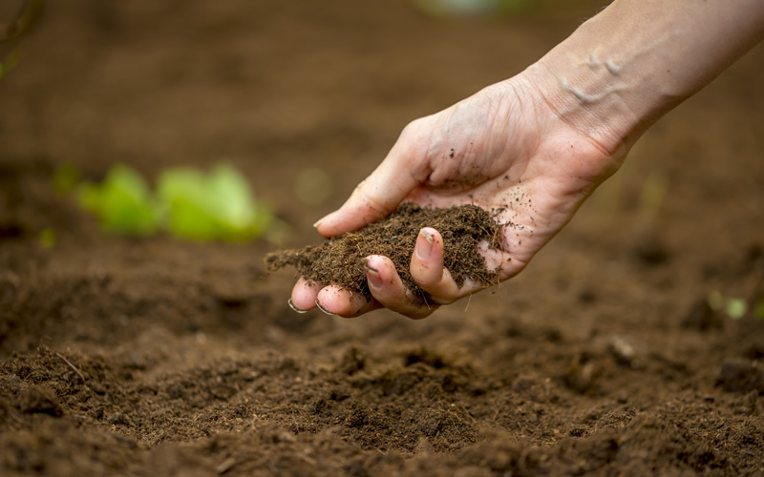
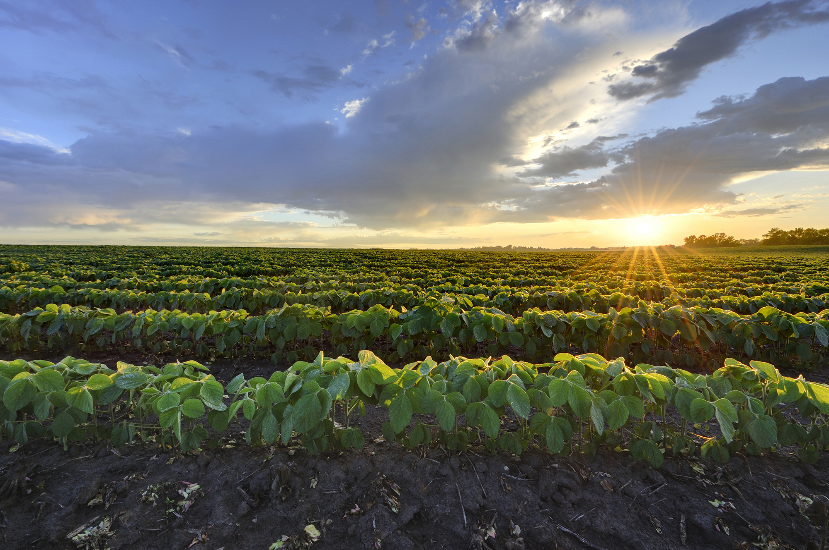
Objectives
Increase in productivity
Improved soil fertility
Effective irrigation

Slide 6
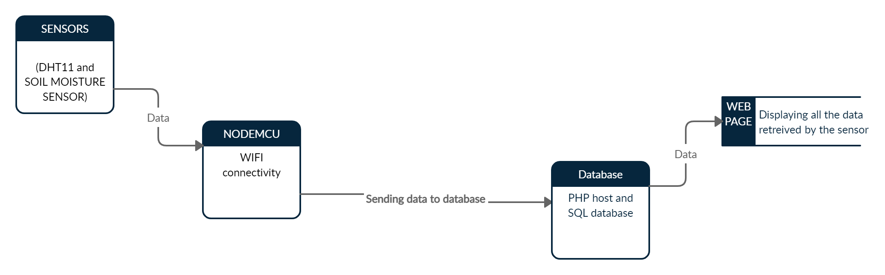
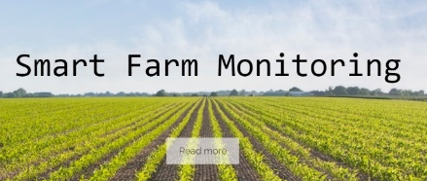
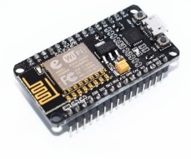

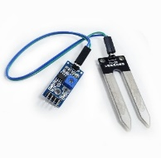
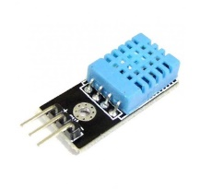
Methodology used

Slide 7
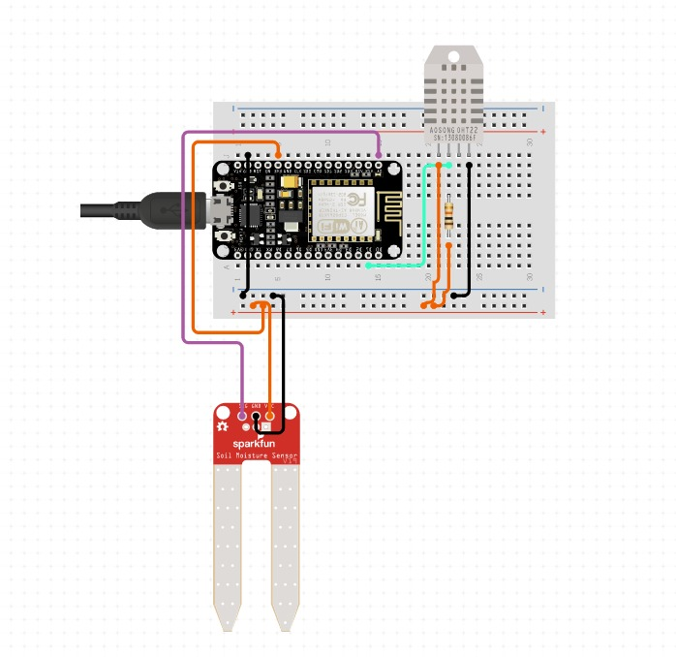
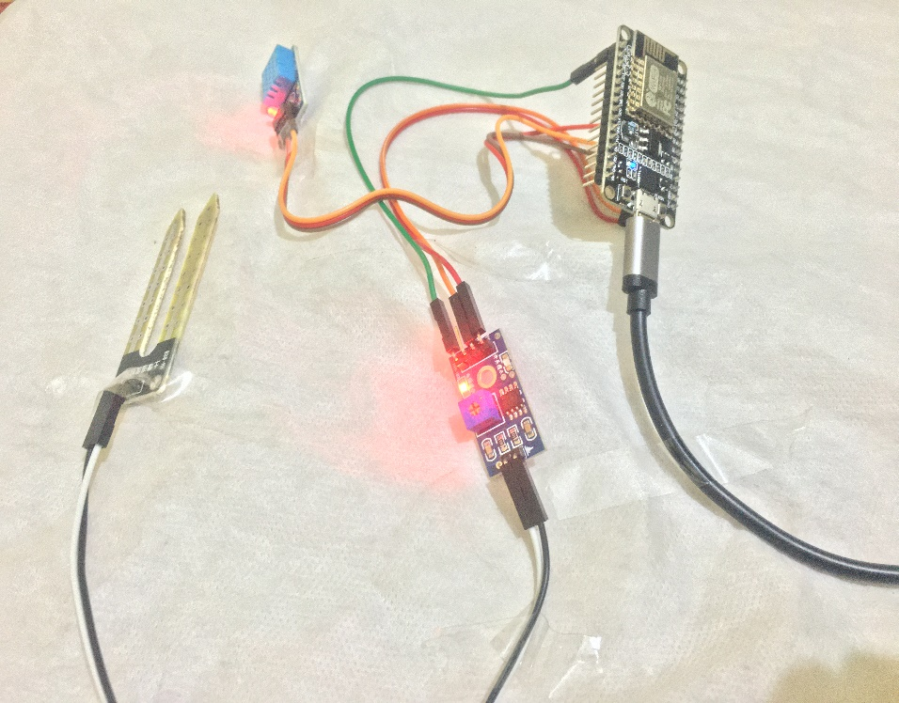
Circuit diagram
Figure 1 shows the circuit built for online stimulation
Figure 2 shows the circuit built for live monitoring of the farm/greenhouse

Slide 8
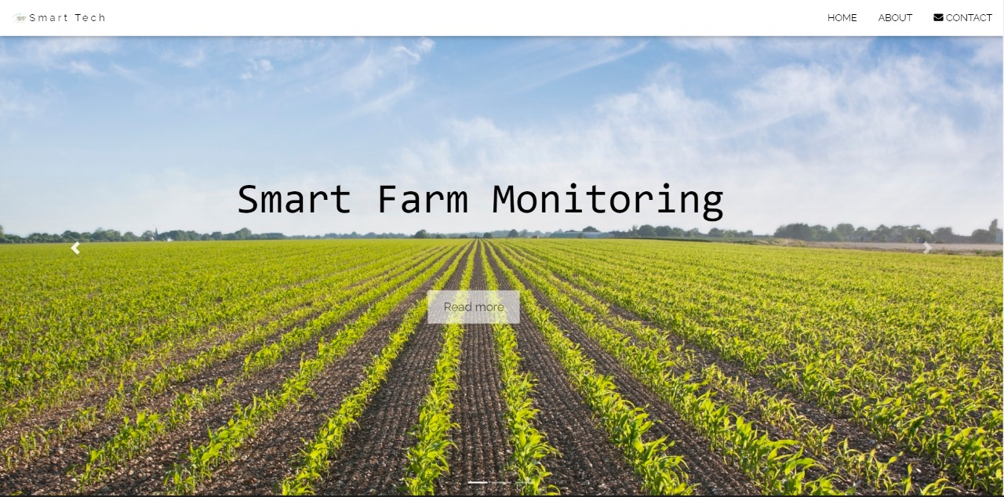
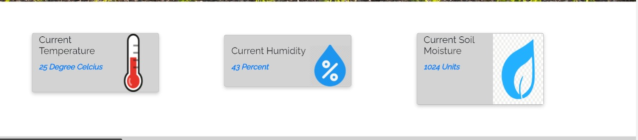
Result and Output

Slide 9
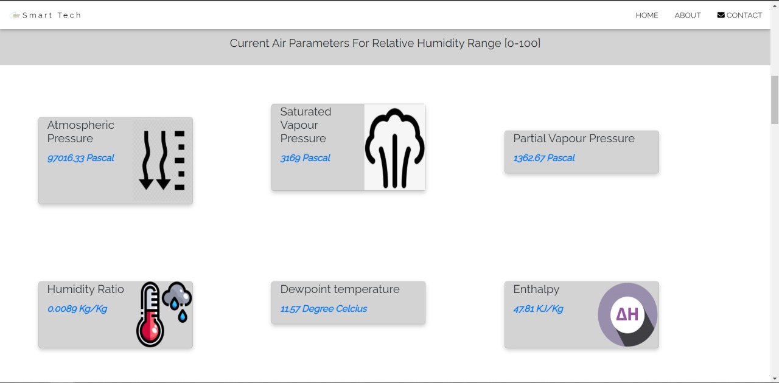
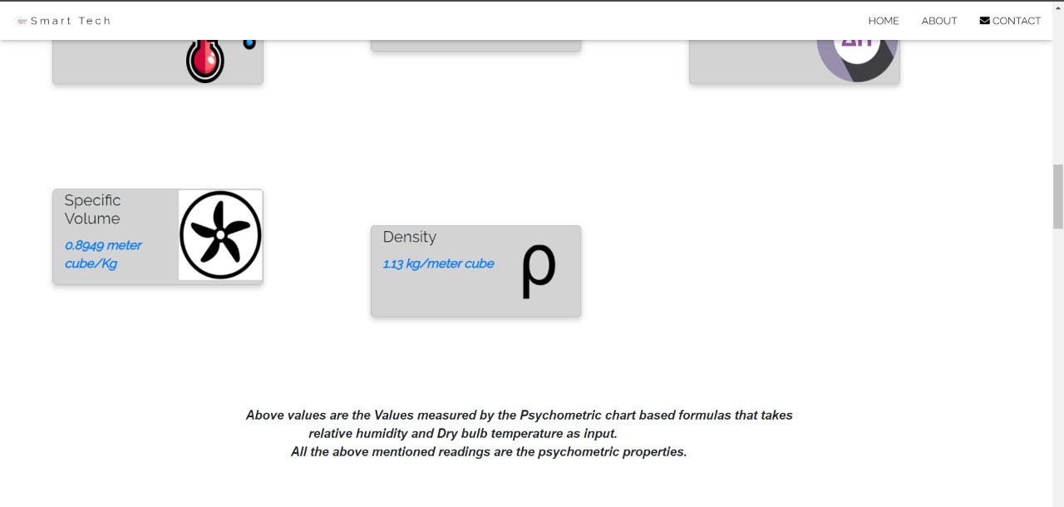

Slide 10
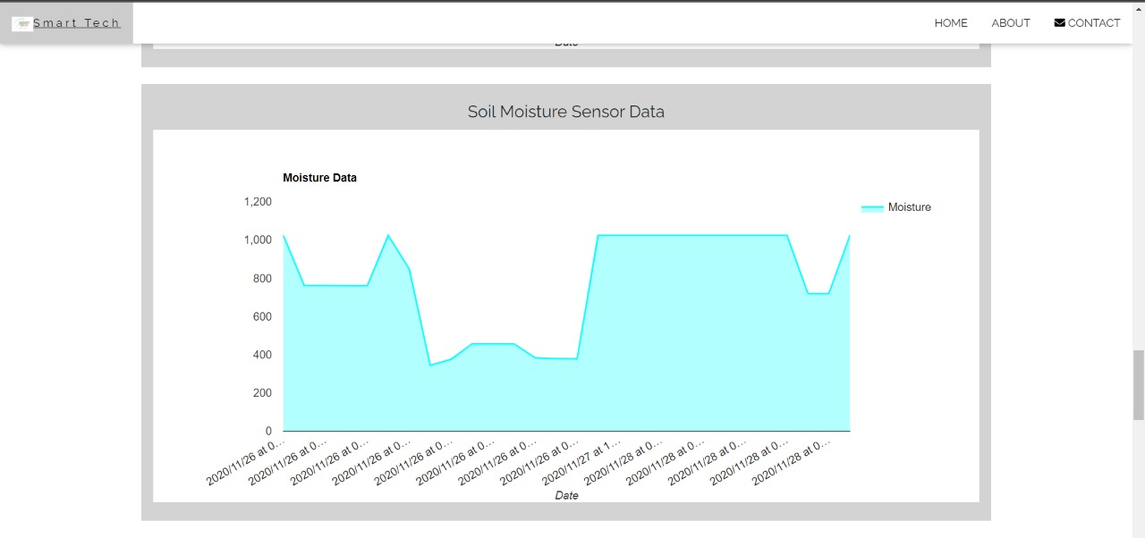
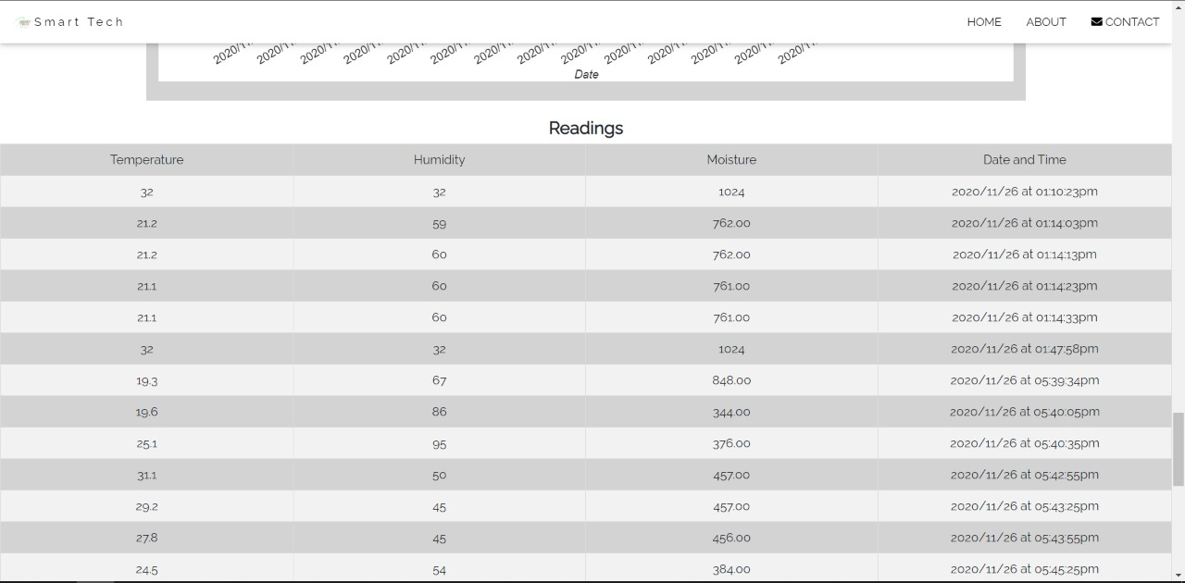

Slide 11


Conclusion
Provide accurate result.
Reliable
efficient
Cheap than existing devices.

Slide 12
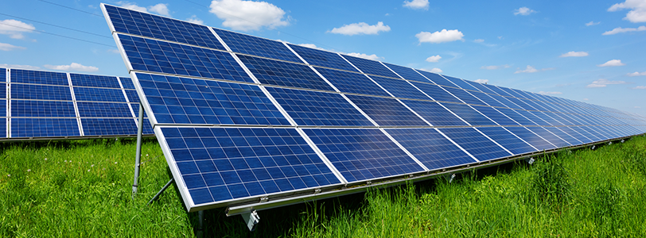

Future Scope
We can use solar panels for power supply in the farms and deployments of the sensors.
Cloud computing technology can be added for making farmers to advise each other and discuss all over the globe about various parameters.

Slide 13
References
http://dx.doi.org/10.1016/j.compag.2016.04.025
https://ieeexplore.ieee.org/document/8538702
https://www.ijrte.org/wp-content/uploads/papers/v7i5/E1987017519.pdf
https://www.semanticscholar.org/paper/Smart-Agriculture-Based-on-Cloud-Computing-and-IOT-Tong-ke/fa7606fc2abe3d069efef6618d45da7a1dcb8bd5?p2df
https://www.mouser.in/applications/smart-agriculture-sensors

